Slide 1


Slide 2
Intro to Web Applications

Slide 3
Slides and links can be found on Layer Zero’s Github
UNLV Layer Zero Github
root-me web server

Slide 4
HTTP
works with a client-server architecture
transfer hypertext data over the network/web
methods/verbs specify what HTTP should actually attempt to do
HyperText Transfer Protocol

Slide 5
HTTP cont.
Hypertext Transfer Protocol
hypertext: text displayed on a computer display or other electronic devices with references (hyperlinks) to other text that the reader can immediately access
Hypertext Markup Language (HTML)
the standard markup language for creating web pages and web applications
markup language: system for annotating a document in a way that is syntactically distinguishable from the text

Slide 6
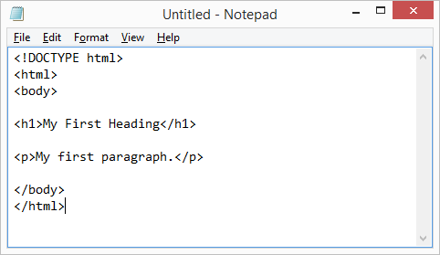
HTTP cont.
HTML / markup example

Slide 7
HTTP cont.
Hypertext Transfer Protocol
protocol: set of rules that dictates how to format, transmit and receive data so computer network devices
you can think of it as an algorithm that defines how a client or server should respond/send particular kinds of data
so a transfer protocol tells computers how to transfer information/data over the network
how the information will be organized, how to understand/read it, how to reply in the same format

Slide 8
HTTP cont.
Combing all this, we can discern that the Hypertext Transfer Protocol
defines how a client and server should transfer hypertext (HTML) over the network

Slide 9

HTTP cont.
Client-Server Architecture

Slide 10
HTTP cont.
Client-Server Architecture cont.
the client will ask for some resource from the server
ex. a HTML file
this is an HTTP Request
the server will likely then give the client the requested resource
this is an HTTP Response

Slide 11
HTTP cont.
HTTP Request Methods / Verbs
HTTP defines a set of request methods to indicate the desired action to be performed for a given resource
HTML Method | Meaning
GET | retrieve a resource (file for reading, etc.)
HEAD | like GET, but only retrieves header & status code (404, 500, etc.)
POST | send data to the server

Slide 12
curl
command line utility
used to transfer data
supports HTTP methods, FTP, LDAP, SCP, etc.
(Client URL)

